Slide 1
Proper Payroll Procedures Are Important…
To make sure employees receive fair pay
To reduce processing time in the finance office
To improve town auditing procedures
Make sure…
You use a non-corrupted form and the proper procedures (download form accounting home page)
Double check your work
Submit to accounting NLT Monday at 5pm of work week

Slide 2
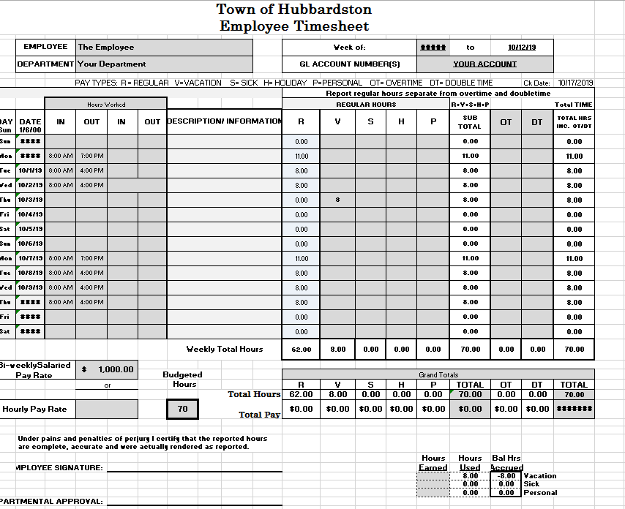
Enter warrant date
Enter Name
For the warrant date:
1.) Enter the pay period start date directly from the official FY20 warrant date sheet. Do not enter the pay period end date as this will auto populate
2.) Enter the check date directly from the official FY20 warrant date sheet.
3.) All times must be entered in this format 00:00 AM. The format is important.
4.) The formatting in this sheet is set…enter only the data necessary and everything else will auto-populate
Enter account
Enter Dept.
Enter daily time
Enter check date
Enter any authorized leave
Enter approved salary or hourly rate
Enter biweekly hours
Don’t change this area!
Enter Name

