Slide 1
Proper Warrant Procedures Are Important…
To make sure we spend money as appropriated
To reduce processing time in the finance office due to mistakes
We are publishing ALL transactions as part of an open checkbook initiative
Make sure…
You double check the accounts
Include proper back up as defined by accounting procedures
You pay ALL bills within 30 days

Slide 2
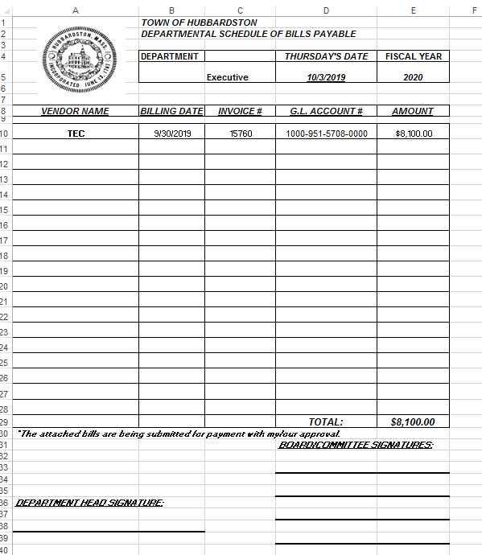
Enter warrant date
For the warrant date:
1.) Use the “Thursday” date from the published warrant calendar
2.) Make sure you have enough funds in your account before warranting a payment
3.) All vendors must have a W9 on file. Please help accounting by submitting these for new vendors
4.) Once filed, bring warrants to your boards and committees for their review. You do not need to turn this in, but our auditors will look at it
Enter fiscal year
Enter Dept.
Use proper vendor name
Use proper amount
Use proper budget account
Use invoice # from bill
Use date from bill
Don’t change this area!
Your signature

